Slide 1


RITALEE MONDE
04/10/2024

Slide 2

Outline
Executive Summary
Introduction
Methodology
Results
Conclusion
Appendix

Slide 3
Executive Summary
Summary of methodologies
Data Collection Data Wrangling EDA Data Visualization EDA with SQL Predictive Analysis
Interactive Map With Folium
Interactive Dashboard Using Plotly
Summary of all results
Exploratory Data Analysis
Predictive Analysis Results

Slide 4
Introduction
Project background and context
SpaceX, a private aerospace company, offers satellite launches at significantly lower costs—about 70% cheaper than its competitors—by reusing its rockets for multiple launches.
Problem
This project aims to analyze historical data from Falcon 9 launches to predict the likelihood of a booster successfully returning to its landing pad. Key factors influencing this outcome include the launch site, payload orbit, payload mass, landing pad location, and the booster version.

Slide 5

Section 1

Slide 6
Methodology
Data Collection: Data was gathered using APIs and web scraping techniques, transforming it into structured formats like dataframes for analysis.
Data Wrangling: Extracting and transforming data into meaningful variables for analysis, including converting categorical data into numerical representations.
Exploratory Data Analysis: Analysis of launch data through visualization to gain insights about launch patterns, payload capacities, and success rates.
Predictive Analysis: Machine learning models were used to predict launch outcomes based on various factors, with the best model achieving an accuracy of 77%.

Slide 7
Data Collection
REST API: Data was retrieved in JSON format through REST API, then converted into a dataframe using python’s panda library with the normalize function
WEB SCRAPING :SpaceX launch data was scraped from Wikipedia and transformed into a dataframe for analysis

Slide 8
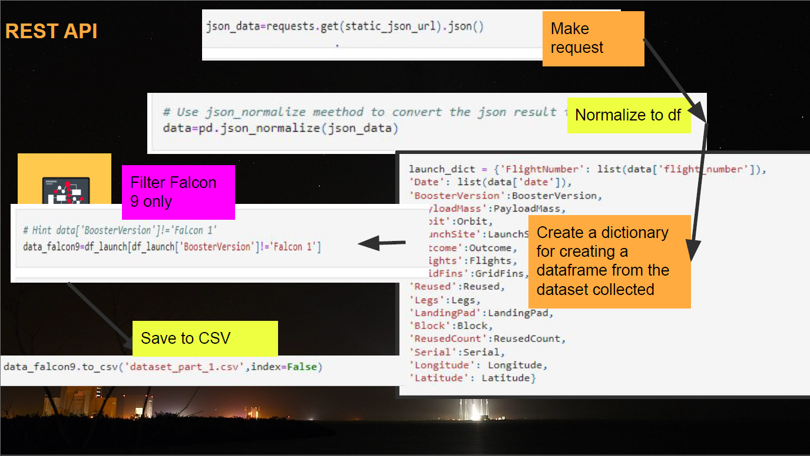
Data Collection – SpaceX API

Slide 9
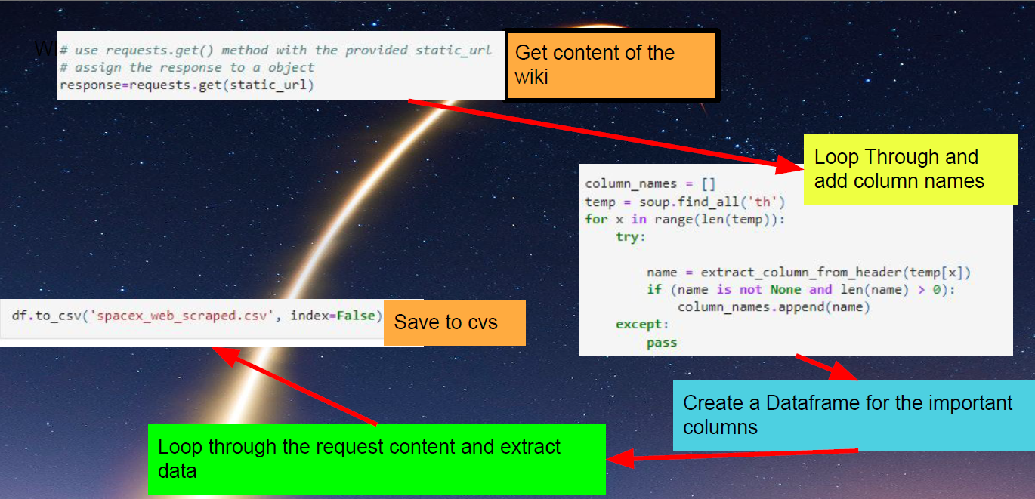
Data Collection – SpaceX API

Slide 10
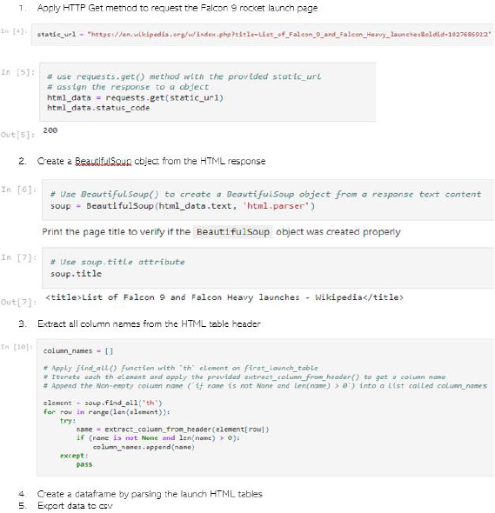
Data Collection - Scraping
We utilized web scraping to extract Falcon 9 launch records using Beautiful Soup.
We then parsed the table and transformed it into a pandas Dataframe.

Slide 11
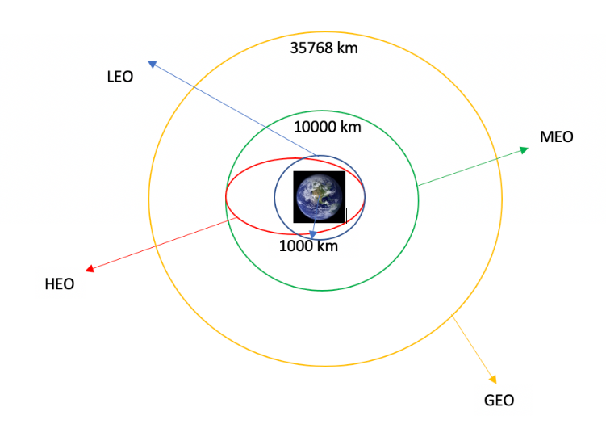
Data Wrangling
We conducted exploratory data analysis and identified the training labels.
We counted the number of launches at each site and the frequency of each orbit.
Additionally, we generated landing outcome labels from the outcome column and exported the results to a CSV file.

Slide 12
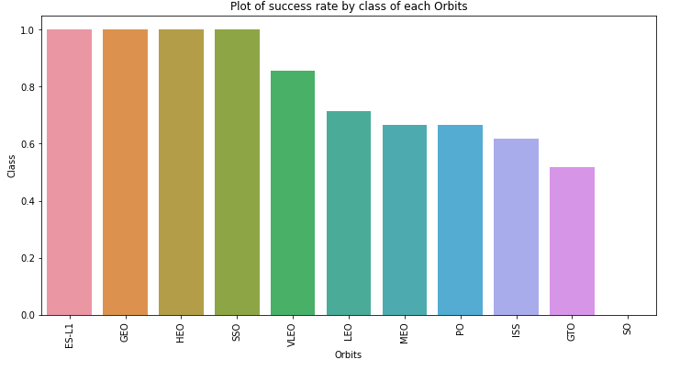
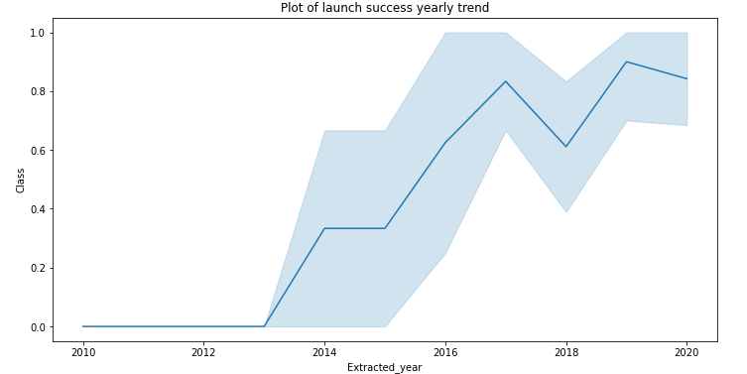
EDA with Data Visualization
Data was examined by visualizing the connections between flight number and launch site, payload and launch site, success rates for each orbit type, flight number and orbit type, as well as the yearly trends in launch success.

Slide 13
EDA with SQL
The SpaceX dataset was loaded into a PostgreSQL database directly from the Jupyter notebook.
Exploratory data analysis (EDA) was performed using SQL to gain insights from the data.
Queries were written to determine, for example:
The names of unique launch sites in the space mission.
The total payload mass carried by boosters launched by NASA (CRS).
The average payload mass carried by booster version F9 v1.1.
The total number of successful and failed mission outcomes.
The failed landing outcomes on the drone ship, along with their booster versions and launch site names.

Slide 14
Build an Interactive Map with Folium
All launch sites were marked, and map elements such as markers, circles, and lines were added to indicate the success or failure of launches for each site on the Folium map.
The feature for launch outcomes was assigned class labels: 0 for failure and 1 for success.
Using color-coded marker clusters, launch sites with relatively high success rates were identified.
Distances between each launch site and nearby areas were calculated, allowing for the exploration of questions such as:
Are launch sites located near railways, highways, and coastlines?
Do launch sites maintain a certain distance from cities?

Slide 15
Build a Dashboard with Plotly Dash
An interactive dashboard was created using Plotly Dash.
Pie charts were generated to display the total number of launches at specific sites.
Additionally, a scatter plot was created to illustrate the relationship between outcomes and payload mass (in kg) for different booster versions.
Add the GitHub URL of your completed Plotly Dash lab, as an external reference and peer-review purpose

Slide 16
Predictive Analysis (Classification)
We loaded the data using numpy and pandas, transformed the data, split our
data into training and testing.
We built different machine learning models and tune different hyperparameters using GridSearchCV
We used accuracy as the metric for our model, improved the model using feature engineering and algorithm tuning.
We found the best performing classification model.
Add the GitHub URL of your completed predictive analysis lab, as an external reference and peer-review purpose

Slide 17
Results
Exploratory data analysis results
Interactive analytics demo in screenshots
Predictive analysis results

Slide 18

Section 2

Slide 19
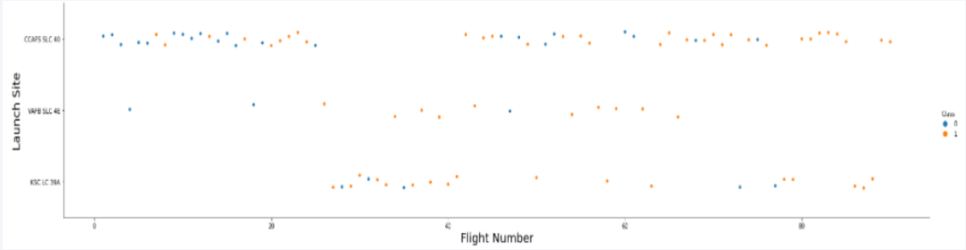
Flight Number vs. Launch Site
From the plot, we found that the larger the flight amount at a launch site, the greater
the success rate at a launch site.
Show the screenshot of the scatter plot with explanations

Slide 20
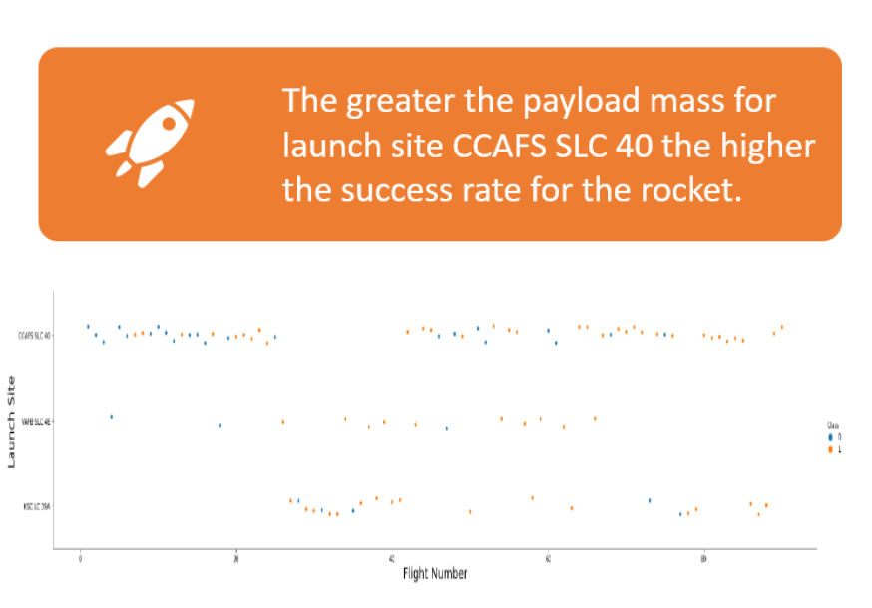
Payload vs. Launch Site

Slide 21
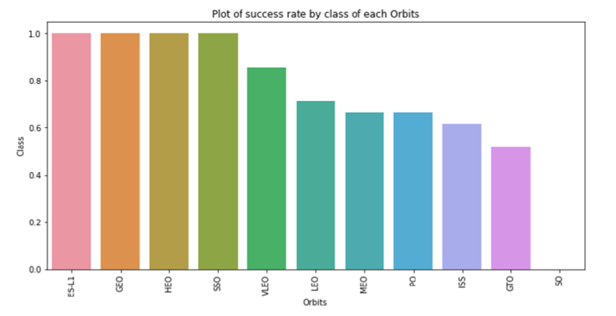
Success Rate vs. Orbit Type
From the plot, we can see that ES-L1, GEO, HEO, SSO, VLEO had the most success rate.

Slide 22
Flight Number vs. Orbit Type
Show a scatter point of Flight number vs. Orbit type
Show the screenshot of the scatter plot with explanations

Slide 23
Payload vs. Orbit Type
Show a scatter point of payload vs. orbit type
Show the screenshot of the scatter plot with explanations

Slide 24
Launch Success Yearly Trend
Show a line chart of yearly average success rate
Show the screenshot of the scatter plot with explanations

Slide 25
All Launch Site Names
Find the names of the unique launch sites
Present your query result with a short explanation here

Slide 26
Launch Site Names Begin with 'CCA'
Find 5 records where launch sites begin with `CCA`
Present your query result with a short explanation here

Slide 27
Total Payload Mass
Calculate the total payload carried by boosters from NASA
Present your query result with a short explanation here

Slide 28
Average Payload Mass by F9 v1.1
Calculate the average payload mass carried by booster version F9 v1.1
Present your query result with a short explanation here

Slide 29
First Successful Ground Landing Date
Find the dates of the first successful landing outcome on ground pad
Present your query result with a short explanation here

Slide 30
Successful Drone Ship Landing with Payload between 4000 and 6000
List the names of boosters which have successfully landed on drone ship and had payload mass greater than 4000 but less than 6000
Present your query result with a short explanation here

Slide 31
Total Number of Successful and Failure Mission Outcomes
Calculate the total number of successful and failure mission outcomes
Present your query result with a short explanation here

Slide 32
Boosters Carried Maximum Payload
List the names of the booster which have carried the maximum payload mass
Present your query result with a short explanation here

Slide 33
2015 Launch Records
List the failed landing_outcomes in drone ship, their booster versions, and launch site names for in year 2015
Present your query result with a short explanation here

Slide 34
Rank Landing Outcomes Between 2010-06-04 and 2017-03-20
Rank the count of landing outcomes (such as Failure (drone ship) or Success (ground pad)) between the date 2010-06-04 and 2017-03-20, in descending order
Present your query result with a short explanation here

Slide 35

Section 3

Slide 36
<Folium Map Screenshot 1>
Replace <Folium map screenshot 1> title with an appropriate title
Explore the generated folium map and make a proper screenshot to include all launch sites’ location markers on a global map
Explain the important elements and findings on the screenshot

Slide 37
<Folium Map Screenshot 2>
Replace <Folium map screenshot 2> title with an appropriate title
Explore the folium map and make a proper screenshot to show the color-labeled launch outcomes on the map
Explain the important elements and findings on the screenshot

Slide 38
<Folium Map Screenshot 3>
Replace <Folium map screenshot 3> title with an appropriate title
Explore the generated folium map and show the screenshot of a selected launch site to its proximities such as railway, highway, coastline, with distance calculated and displayed
Explain the important elements and findings on the screenshot

Slide 39

Section 4

Slide 40
<Dashboard Screenshot 1>
Replace <Dashboard screenshot 1> title with an appropriate title
Show the screenshot of launch success count for all sites, in a piechart
Explain the important elements and findings on the screenshot

Slide 41
<Dashboard Screenshot 2>
Replace <Dashboard screenshot 2> title with an appropriate title
Show the screenshot of the piechart for the launch site with highest launch success ratio
Explain the important elements and findings on the screenshot

Slide 42
<Dashboard Screenshot 3>
Replace <Dashboard screenshot 3> title with an appropriate title
Show screenshots of Payload vs. Launch Outcome scatter plot for all sites, with different payload selected in the range slider
Explain the important elements and findings on the screenshot, such as which payload range or booster version have the largest success rate, etc.

Slide 43

Section 5

Slide 44
Classification Accuracy
Visualize the built model accuracy for all built classification models, in a bar chart
Find which model has the highest classification accuracy

Slide 45
Confusion Matrix
Show the confusion matrix of the best performing model with an explanation

Slide 46
Conclusions
Point 1
Point 2
Point 3
Point 4
…

Slide 47
Appendix
Include any relevant assets like Python code snippets, SQL queries, charts, Notebook outputs, or data sets that you may have created during this project

Slide 48


